Slide 1
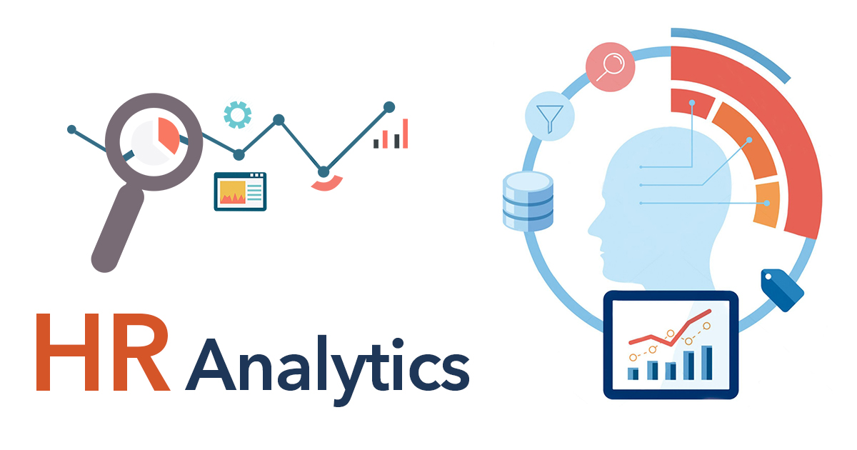

Slide 2
Introduction
In this project HR data is analyzed. few visualizations are created to allow us to understand certain employee metrics.
Tools used
Microsoft Power Bi for cleaning, analysis and visualization

Slide 3

Total no of employees
Insights:
Major part of the employees are male.

Slide 4
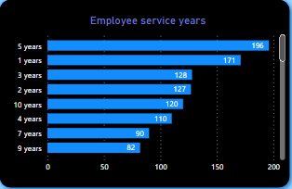
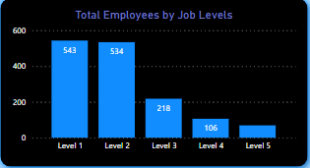
Count of employees based on service years and job levels
Insights:
More number of the employees are working in the company for 5 yrs.
Highest number of employees are working in level 1.

Slide 5
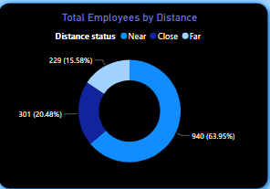
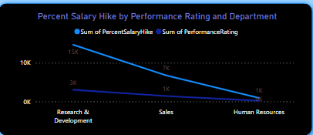
Over 64% of employees are staying close to the company within a radius of 10 km.
Employees from research and development department are receiving highest salary hikes.

Slide 6
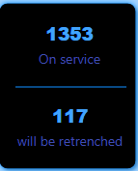
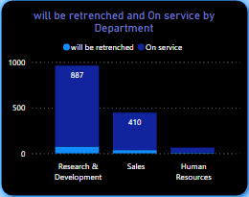
Insights:
Employees who are in service are more when compared to those who might face retrenchment.

Slide 7
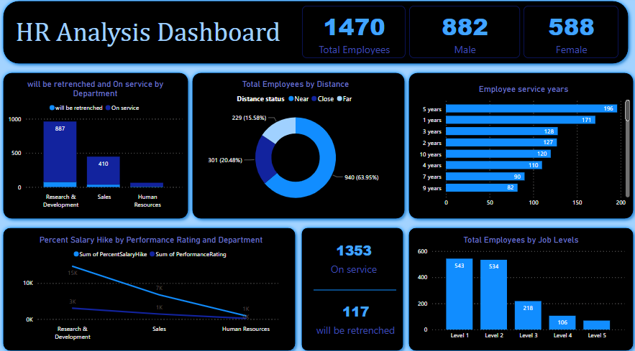
Final dashboard

Slide 8
Way forward
Steps should be taken to recruit more employees for higher levels.
Female employees should be encouraged more by providing necessary leaves.
Employees should be promoted to higher levels to retain them in the company for more years.

Slide 9
Thank You
Any Questions?

